Slide 1
Peer Consultation
2/7/25

Slide 2
Confidentiality

Slide 3
Defining the Dilemma: Seeing Chronic Absenteeism related Issues through a Different Lens
Chronic absenteeism remains a persistent challenge, despite ongoing efforts to improve student engagement and success. While data may point to attendance patterns-the underlying factors-whether related to school culture, instructional practices, staff values and beliefs, or systematic barriers-are complex and interconnected.

Slide 4
Consider your professional dilemma related to chronic absenteeism.

Slide 5
Give a BRIEF overview of your dilemma
30 seconds each

Slide 6
Choose one dilemma to “unpack” as a group.
How might we look at this challenge differently to uncover new perspectives and potential entry points for change?

Slide 7
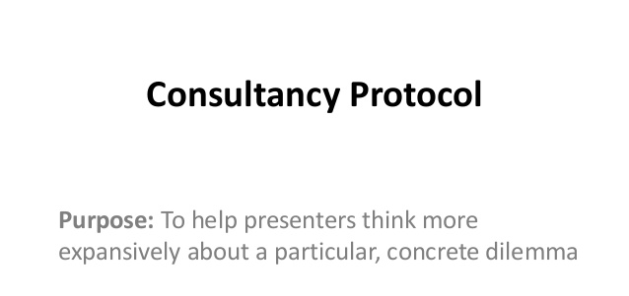
Purpose: To help one another think more expansively about a particular concrete dilemma.

Slide 8
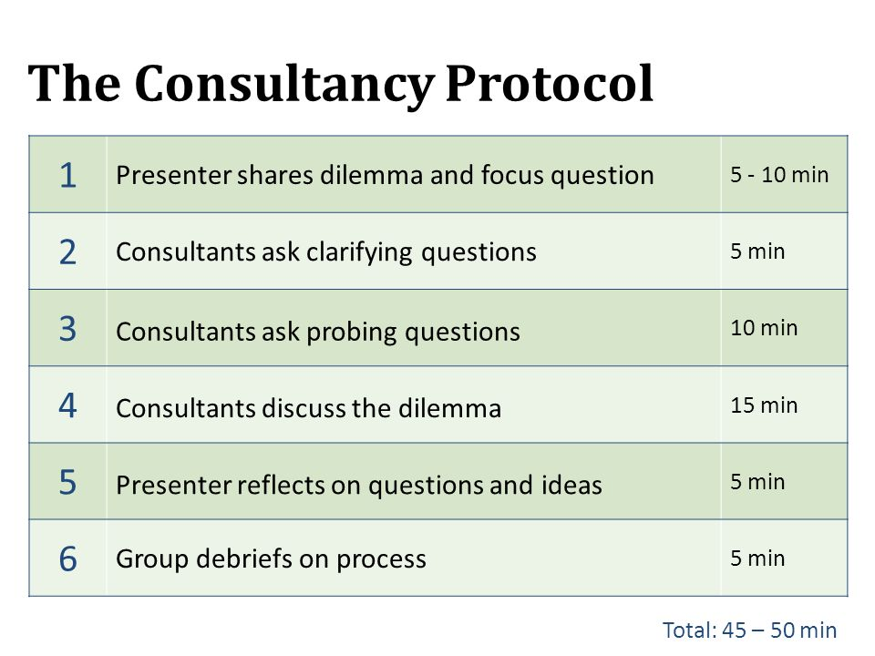

Slide 9
Why do you think this is the case?
What would have to change
What do you feel is right?
What’s another way you might ___?
How is ___ different from ___?
What sort of an impact do you think ___?
How did you decide/determine/conclude ___
What is the connection between ___ and ___?
What if the opposite were true? Then what?
How might your assumptions about ___ have influenced how you are thinking about ___?
What is your fear?
What do you need to ask to better understand?
How do you feel when ___? What might this tell you about ___?
If you were ___, how would you see this situation?
Sample Clarifying Questions

Slide 10
Consultants Discuss
What did we hear?
What didn’t we hear that might be relevant?
What assumptions seem to be operating?
What questions does the dilemma raise for us?
What do we think about the dilemma?
What might we do or try if faced with similar dilemma?

Slide 11
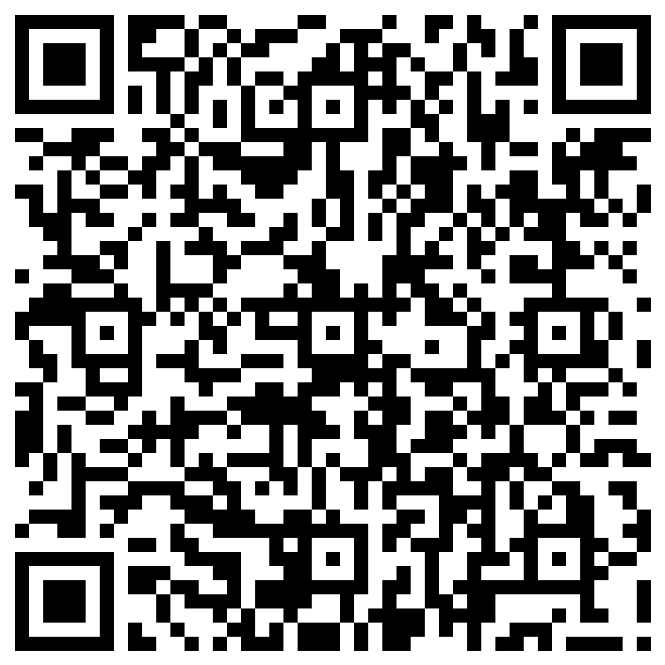
Thank You!

